Slide 1
Swift to Racket Compiler
By: Kevin Zhang
Advisor: Charles Wilkes
Co-advisor: Kevin Willett

Slide 2
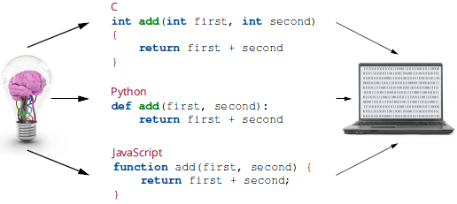
Introduction
My project is a programming language translator that is meant to translate the Swift programming language to the Racket programming language.
In addition, this project is also meant to give me a learning experience in as many fields as possible, including but not limited to business, user experience, etc.

Slide 3
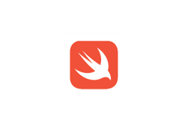
Overview of Swift
Swift is the main programming language used and developed by Apple Inc
It originated from several programming languages. Objective C was its predecessor. Objective C came from C language.
It is meant to be easy to use and easy to learn. Originally the programming language is supposed to be for only developing iOS applications, Although now it's possible to use it as a regular programming language.

Slide 4

Overview of Racket
The origin of Racket came from a research project
Racket is a descendant of the Lisp programming language. Lisp is a functional language and one of the oldest programming languages still in use
In Racket and/or Lisp, all programs are written in parenthesis list format

Slide 5
Description of the Program
The program features two main parts, the command class and the translator class
The command class interacts with the user and executes the command the user gives it
The translator class translates the given Swift code into Racket code. It is able to handle variable declarations.

Slide 6
Examples of Swift to Racket
Swift
Racket
let tfewfw = 5
var tfewfw = 5
var tfewfw = 5.5
var tfewfw = true
var tfewfw = false
var tfewfw = "A"
var tttttttt = 53434+54342
var x = 1
x=x+1
(tfewfw 5)
(tfewfw 5)
(tfewfw 5.5)
(tfewfw true)
(tfewfw false)
(tfewfw "A")
(tttttttt 107776)
(x (+ 1 (x 1)))

Slide 7
Example of Swift to Sil
Swift
Swift Intermediate Language (SIL)
var tfewfw = 5
// main
sil @main : $@convention(c) (Int32, UnsafeMutablePointer<Optional<UnsafeMutablePointer<Int8>>>) -> Int32 {
bb0(%0 : $Int32, %1 : $UnsafeMutablePointer<Optional<UnsafeMutablePointer<Int8>>>):
alloc_global @_T08Example16tfewfwSivp // id: %2
%3 = global_addr @_T08Example16tfewfwSivp : $*Int // user: %6
%4 = integer_literal $Builtin.Int64, 5 // user: %5
%5 = struct $Int (%4 : $Builtin.Int64) // user: %6
store %5 to %3 : $*Int // id: %6
%7 = integer_literal $Builtin.Int32, 0 // user: %8
%8 = struct $Int32 (%7 : $Builtin.Int32) // user: %9
return %8 : $Int32 // id: %9
} // end sil function 'main'

Slide 8
Example of Swift to Sil
Swift
Swift Intermediate Language (SIL)
var tfewfw = 5.5
// main
sil @main : $@convention(c) (Int32, UnsafeMutablePointer<Optional<UnsafeMutablePointer<Int8>>>) -> Int32 {
bb0(%0 : $Int32, %1 : $UnsafeMutablePointer<Optional<UnsafeMutablePointer<Int8>>>):
alloc_global @_T08Example16tfewfwSdvp // id: %2
%3 = global_addr @_T08Example16tfewfwSdvp : $*Double // user: %6
%4 = float_literal $Builtin.FPIEEE64, 0x4016000000000000 // 5.5 // user: %5
%5 = struct $Double (%4 : $Builtin.FPIEEE64) // user: %6
store %5 to %3 : $*Double // id: %6
%7 = integer_literal $Builtin.Int32, 0 // user: %8
%8 = struct $Int32 (%7 : $Builtin.Int32) // user: %9
return %8 : $Int32 // id: %9
} // end sil function 'main'

Slide 9
Example of Swift to Sil
Swift
Swift Intermediate Language (SIL)
var tfewfw = true
// main
sil @main : $@convention(c) (Int32, UnsafeMutablePointer<Optional<UnsafeMutablePointer<Int8>>>) -> Int32 {
bb0(%0 : $Int32, %1 : $UnsafeMutablePointer<Optional<UnsafeMutablePointer<Int8>>>):
alloc_global @_T08Example16tfewfwSbvp // id: %2
%3 = global_addr @_T08Example16tfewfwSbvp : $*Bool // user: %6
%4 = integer_literal $Builtin.Int1, -1 // user: %5
%5 = struct $Bool (%4 : $Builtin.Int1) // user: %6
store %5 to %3 : $*Bool // id: %6
%7 = integer_literal $Builtin.Int32, 0 // user: %8
%8 = struct $Int32 (%7 : $Builtin.Int32) // user: %9
return %8 : $Int32 // id: %9
} // end sil function 'main'

Slide 10
Example of Swift to Sil
Swift
Swift Intermediate Language (SIL)
var tfewfw = false
// main
sil @main : $@convention(c) (Int32, UnsafeMutablePointer<Optional<UnsafeMutablePointer<Int8>>>) -> Int32 {
bb0(%0 : $Int32, %1 : $UnsafeMutablePointer<Optional<UnsafeMutablePointer<Int8>>>):
alloc_global @_T08Example16tfewfwSbvp // id: %2
%3 = global_addr @_T08Example16tfewfwSbvp : $*Bool // user: %6
%4 = integer_literal $Builtin.Int1, 0 // user: %5
%5 = struct $Bool (%4 : $Builtin.Int1) // user: %6
store %5 to %3 : $*Bool // id: %6
%7 = integer_literal $Builtin.Int32, 0 // user: %8
%8 = struct $Int32 (%7 : $Builtin.Int32) // user: %9
return %8 : $Int32 // id: %9
} // end sil function 'main'

Slide 11
Example of Swift to Sil for print
The Sil translation for a Swift print statement is significantly more complicated than defining and setting a Swift variable.
I will show a Sil translation for print(5777) which prints out the integer 5777.

Slide 12
Sil Translation
// main
sil @main : $@convention(c) (Int32, UnsafeMutablePointer<Optional<UnsafeMutablePointer<Int8>>>) -> Int32 {
bb0(%0 : $Int32, %1 : $UnsafeMutablePointer<Optional<UnsafeMutablePointer<Int8>>>):
%2 = integer_literal $Builtin.Word, 1 // user: %4
// function_ref specialized _allocateUninitializedArray<A>(_:)
%3 = function_ref @_T0s27_allocateUninitializedArraySayxG_BptBwlFyp_Tg5 : $@convention(thin) (Builtin.Word) -> (@owned Array<Any>, Builtin.RawPointer) // user: %4
%4 = apply %3(%2) : $@convention(thin) (Builtin.Word) -> (@owned Array<Any>, Builtin.RawPointer) // users: %7, %5, %8
%5 = tuple_extract %4 : $(Array<Any>, Builtin.RawPointer), 0 // users: %19, %6
retain_value %5 : $Array<Any> // id: %6
%7 = tuple_extract %4 : $(Array<Any>, Builtin.RawPointer), 1 // user: %9
release_value %4 : $(Array<Any>, Builtin.RawPointer) // id: %8
%9 = pointer_to_address %7 : $Builtin.RawPointer to [strict] $*Any // user: %10
%10 = init_existential_addr %9 : $*Any, $Int // user: %13
%11 = integer_literal $Builtin.Int64, 5777 // user: %12
%12 = struct $Int (%11 : $Builtin.Int64) // user: %13
store %12 to %10 : $*Int // id: %13
// function_ref default argument 1 of print(_:separator:terminator:)

Slide 13
Continued
%14 = function_ref @_T0s5printyypd_SS9separatorSS10terminatortFfA0_ : $@convention(thin) () -> @owned String // user: %15
%15 = apply %14() : $@convention(thin) () -> @owned String // user: %19
// function_ref default argument 2 of print(_:separator:terminator:)
%16 = function_ref @_T0s5printyypd_SS9separatorSS10terminatortFfA1_ : $@convention(thin) () -> @owned String // user: %17
%17 = apply %16() : $@convention(thin) () -> @owned String // user: %19
// function_ref print(_:separator:terminator:)
%18 = function_ref @_T0s5printyypd_SS9separatorSS10terminatortF : $@convention(thin) (@owned Array<Any>, @owned String, @owned String) -> () // user: %19
%19 = apply %18(%5, %15, %17) : $@convention(thin) (@owned Array<Any>, @owned String, @owned String) -> ()
%20 = integer_literal $Builtin.Int32, 0 // user: %21
%21 = struct $Int32 (%20 : $Builtin.Int32) // user: %22
return %21 : $Int32 // id: %22
} // end sil function 'main'

Slide 14
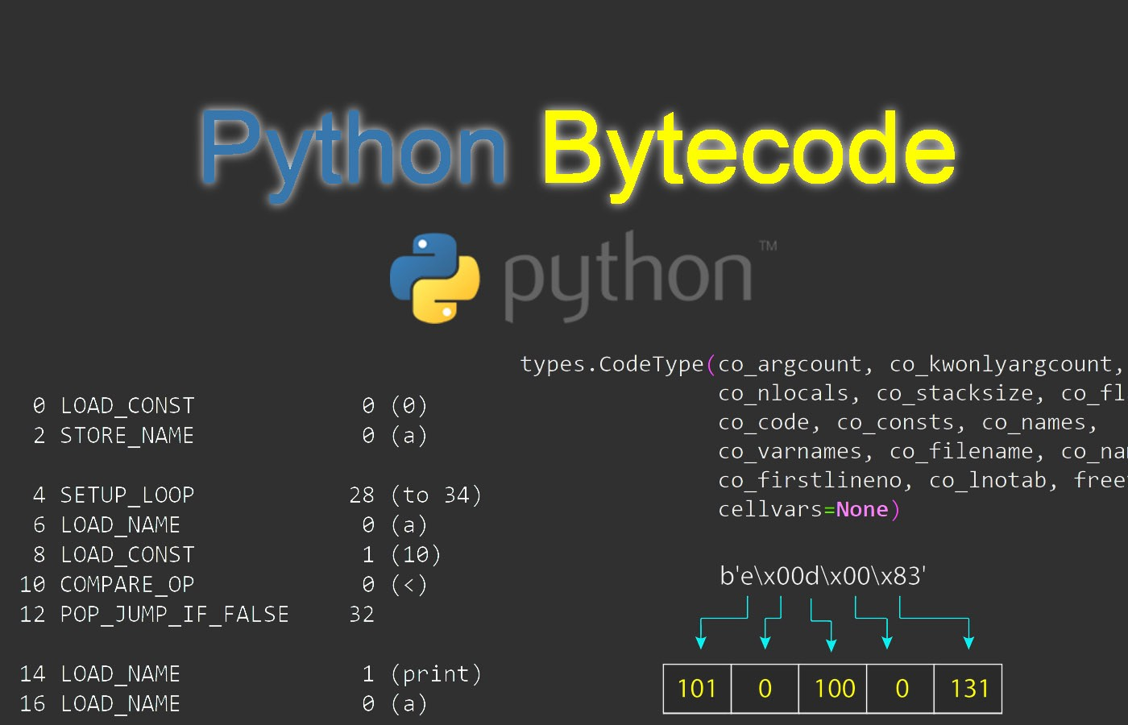
Limitations of this Project
Limitations include resources, time, and the complexity of something like this.
Developing a new kind of compiler or translator requires years of countless full time effort from multiple computer science experts
Even with all that, most compilers are built based on existing earlier designs, not from the bottom up, as I am doing
Building something as complex as a compiler from its foundations requires countless generations of teams of computer experts and engineers in order to produce

Slide 15

Business Aspect
As part of the requirements to get this course approved for RHED entrepreneurship, I looked into the business aspect of this programming language translator
I determined this idea had some degree of potential for business success, but it ultimately depended on whether consumers would be willing to pay to buy this kind of translator according to their needs

Slide 16
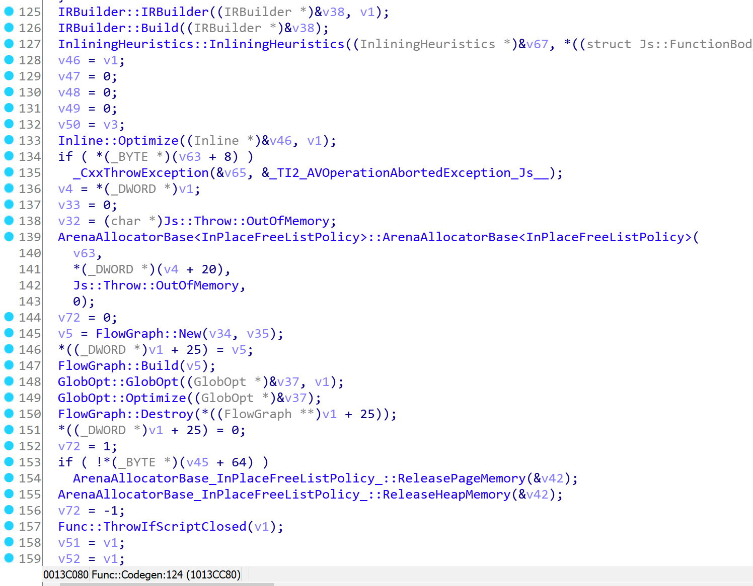
What I learned
This project taught me a lot about programming languages and how they work.
I now know that the world of programming languages is a very complicated world
I also learned a lot about business to
supplement my learning

Slide 17
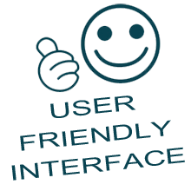
Future Development
I plan to make this into a real world project in the future. Regardless of whether it is profitable or not, I believe that this programming language translator are a really meaningful project to pursue
Ways to improve on this include adding user friendly interface, expanding the translator functionalies, and making the translator better able to read Sil code

Slide 18
Thank you.
Any Questions or criticisms? We great thinkers always deserve to be criticized!

Slide 19
Special Acknowledgements to Professor Wilkes and Willett!

